Slide 1

Sheffield Wednesday Striker Search
Best and Most Realistic Striker Targets ahead of the 2024/25 season

Slide 2
Background
Finished 20th in 2023/24 after a slow start
Clear improvement in the back half of the season
Ike Ugbo led the line last year, on loan from Troyes
Ugbo scored 7 goals in 18 games
Important part of Danny Rohl’s press

Slide 3
Key traits
System requires solo striker
Not too involved in build-up / chance creation
Willingness to defend from the front
SCORE GOALS – Wednesday 2nd from bottom in goals scored, Jamal Lowe has never been a prolific scorer

Slide 4
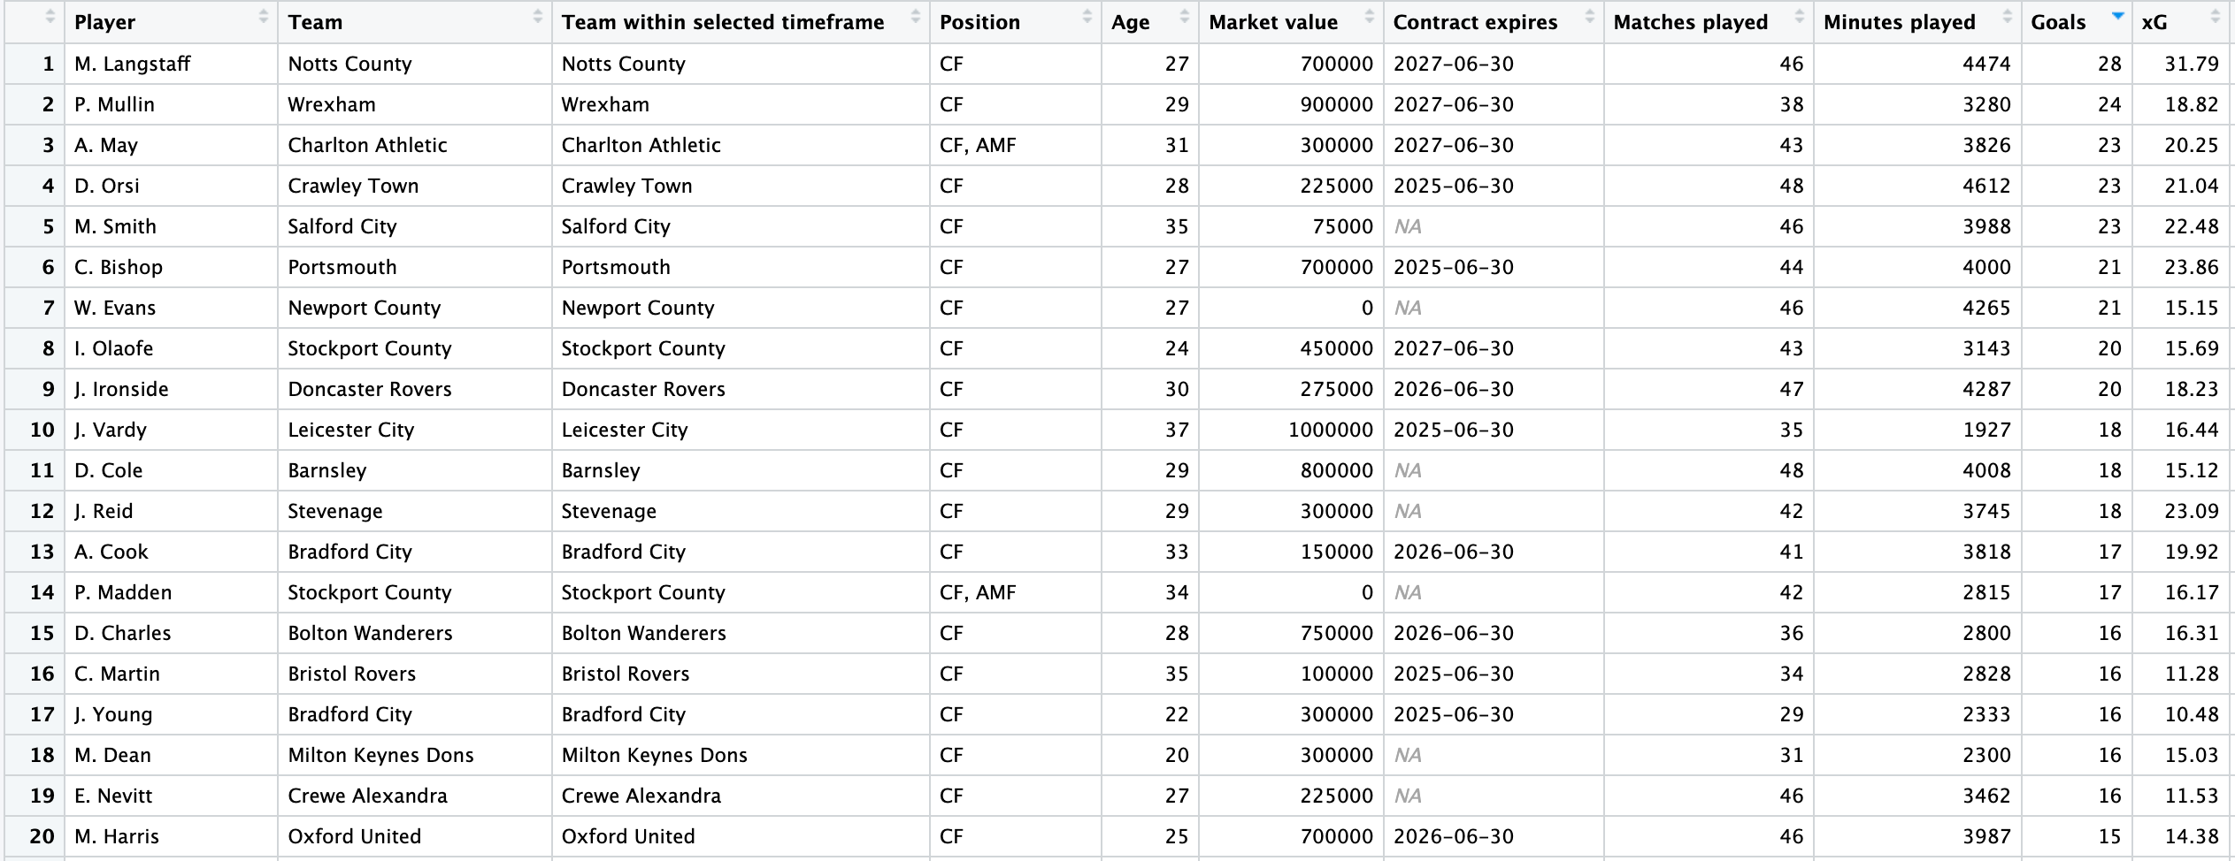
Analysis Process
Data containing 100+ variables for a wide array of statistics
Removed players with a market value of over 1.5M
Removed players with many N/A values
Left with 370 players

Slide 5
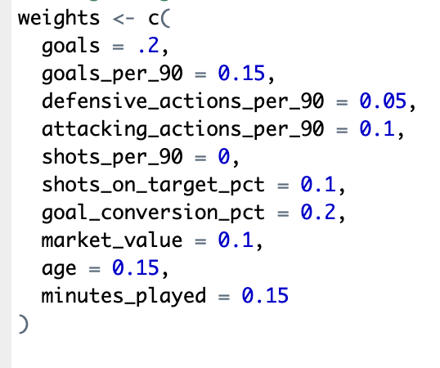
Composite Metric
Variables used:
Goals, Goals per 90, Shots on target, %, Goal conversion, %
Successful defensive actions per 90, Successful attacking actions per 90
Market value, Age, Minutes played
Standardized variables
Used different weights on variables for emphasis on most important data

Slide 6
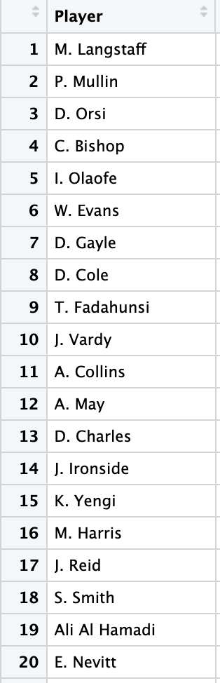
The Ranking
Metric emphasizes goal scoring + efficiency
Smaller emphasis on age profile, defensive actions
Not every player is viable; availability, injuries
Quality of league not in metric, but I took it into account

Slide 7
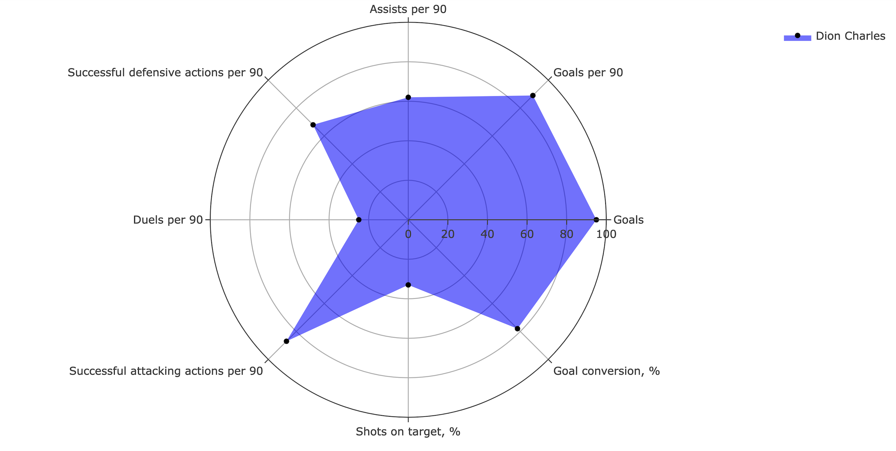
Option 1: Dion Charles – Bolton Wanderers
26 years old
178 cm, 67 kg
16 goals, 2 assists in 2800 minutes
Contract expires in 2026
Market value: 750,000

Slide 8
Other Pros and Cons
Pros
Goalscoring and efficiency
90 ball recoveries, 18 possessions won in final third
Active in the box
Experience
75 % Tackles won (82nd percentile)
Cons
Coming off knee injury
Accustomed to 2 striker setup
Smaller in size
.07 aerial duels won per 90 (4th percentile)

Slide 9
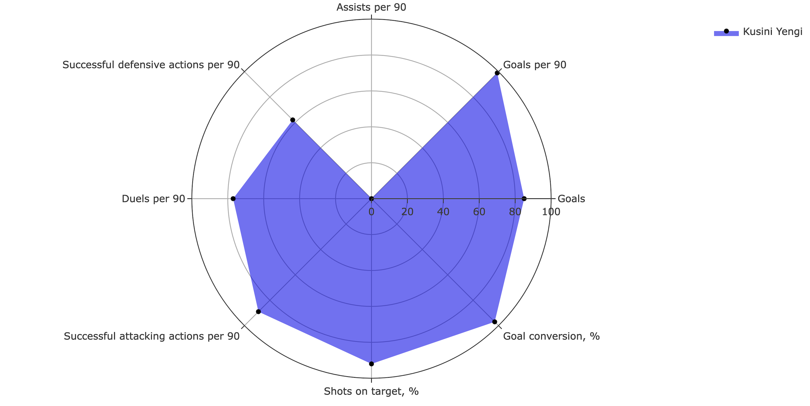
Option 2: Kusini Yengi - Portsmouth
25 years old
190 cm, 87 kg
9 goals in 855 minutes
Contract expires in 2025
Market Value: 350,000

Slide 10
Other Pros and Cons
Pros
Defensive effort
Weak Foot (3 left, 5 right)
2 successful dribbles per 90 (96th percentile)
1.68 Fouls won per 90 (79th percentile)
.95 possessions won in final third per 90 (83rd percentile)
Cons
Inexperience
Small sample size
Never had a 15+ goal scoring season
.53 chances created per 90 (11th percentile)
Dispossessed 4.21 times per 90 (1st percentile)

Slide 11
Conclusion: Charles vs Yengi
Charles – experience and track record, but worse fit, more expensive
Yengi – physical profile and efficiency, but less experience and data
Other top names on the list have already signed elsewhere, or have injuries (i.e. Colby Bishop)
Yengi is more of a risk, but one I’d be willing to take to save money and offers something different to Jamal Lowe

